Slide 1
The Chiron Framework
Revolutionising Knowledge Delivery with LLMs
Notes:
Adib -

Slide 2

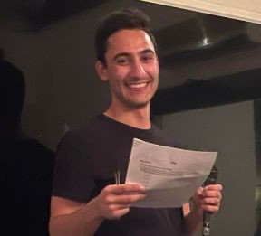





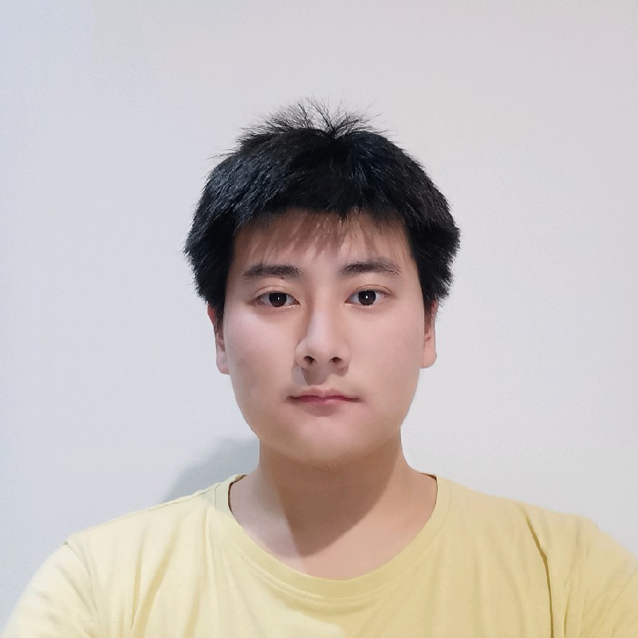
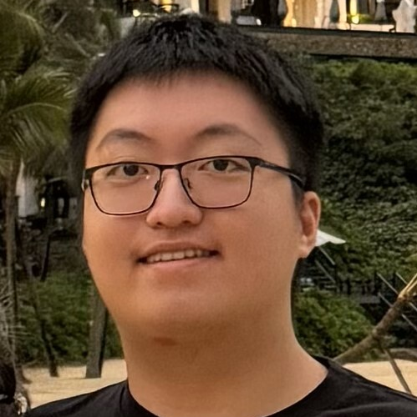


The Team
Lucas Young
Scrum Master
Joseph Hayek
Video Production Lead
Elizabeth Pynadath
Documentation Lead
Sandin Jayasekera
Prompt Engineer
Leo Li
Solutions Architect
Bill Nguyen
Full-stack Software Engineer
Biswas Simkhada
Full-stack Software Engineer
Adib Akbari
Full-stack Software Engineer
Nutanix Confidential
Notes:
Adib

Slide 3
Problem
Feature Set
Demo
Technical Deep Dive
Frontend
Backend
Usage Requirements
Constraints
Future Features
Agenda
Notes:
Adib

Slide 4




Concept
Notes:
Sandin

Slide 5
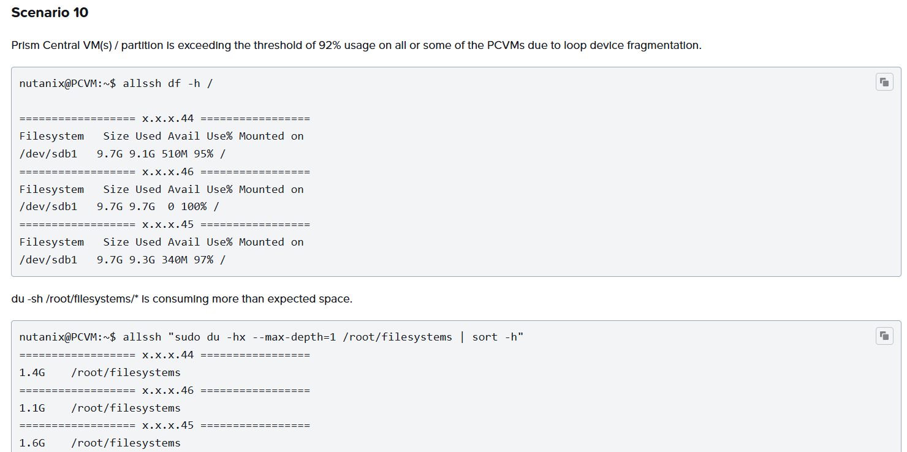
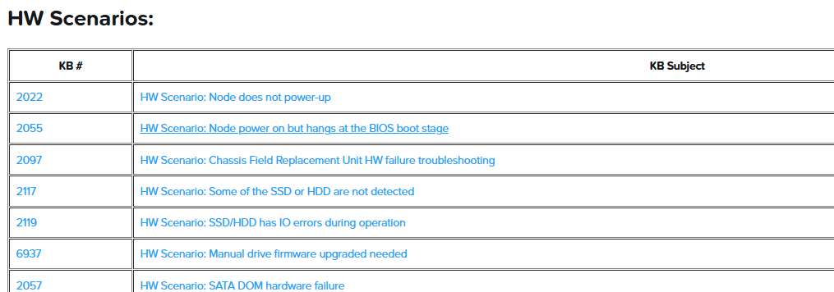
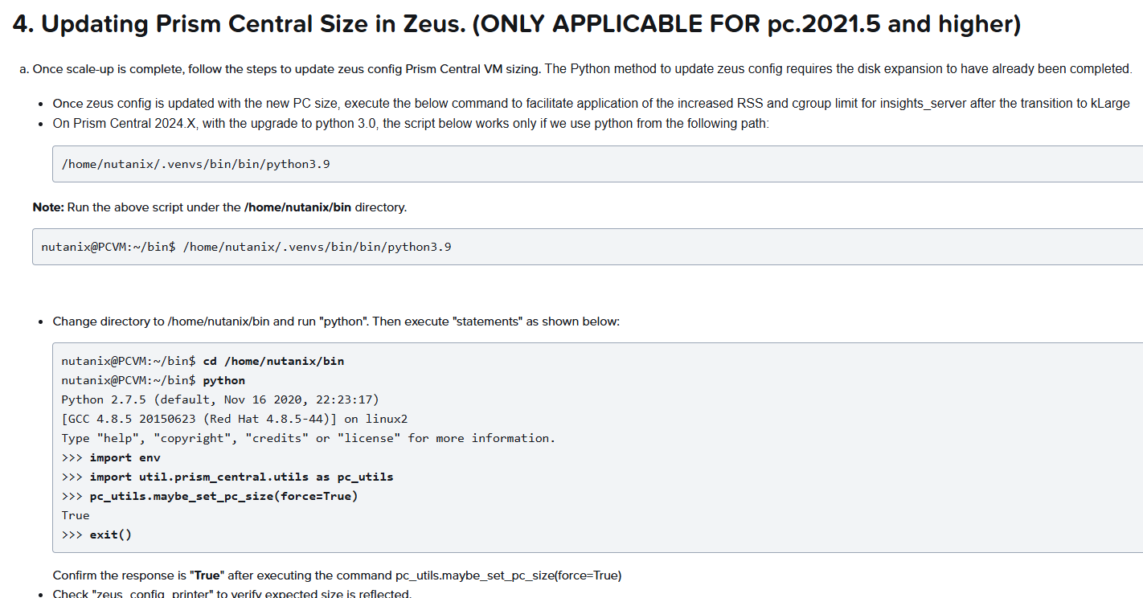
Problem
Pain Points of KBs
Hard to absorb for non-technical customers
Information dense
Difficult to follow
Difficult to guide darksite customers
KB5228 : Too many scenarios
KB2299 : Hyperlinks to other KB articles
KB2579 : Hyperlinks to other KB articles
Notes:
Sandin
Introduce the problem
There were some pain points identified about the KB
Main issue: hard for non-tech ppl
Certain customers may lack confidence to perform actions themselves
Info dense
Info is relevant, but the actual volume may be too dense, which may be intimidating
Can be difficult to follow for customers that may be unfamiliar with nutanix software or CLI.
There may be to many scenarios
Steps may reference other kbs through hyperlinks
Diff. for darksites
Can send pdf, but can’t manually guide customers through, since no remote access
Troubleshooting difficult In these situations if customers can’t do themselves
NCC Health Check: pcvm_disk_usage_check ⇒ 18 sec
Hardware Troubleshooting Guide - List of KBs ⇒ linking a kb to another kbs
Prism Central | Modifying resources to Increase Maximum Supported VMs across all Clusters (Scale-up Prism Central) ⇒ long instructions

Slide 6




High Level Overview
User
User Interface
LLM hosted on Nutanix Cluster
Video Creation
Nutanix Confidential
Notes:
Sandin
We were tasked with coming up with a solution to these issues by converting the KB articles to a video format
Specifically, we came up with was a semi-automated framework for this process
High level overview of our system
User accesses

Slide 7
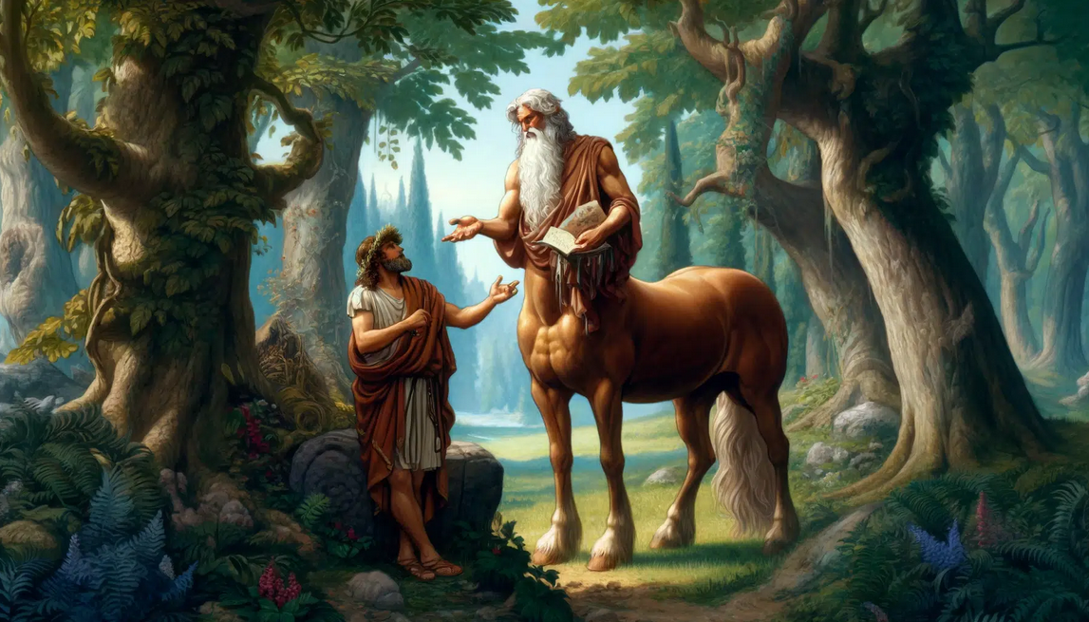
Chiron
[ kai-ruhn ]
noun
a wise and benevolent centaur, known for his great teaching abilities of Achilles, Asclepius, and others.
Our framework, through revolutionising the delivery of KB articles, follows in these footsteps.
Notes:
Lucas
- Keeping in line with Nutanix’s love of naming it’s services after mythological figures, our framework is named Chiron, which was inspired by the wise and benevolent centaur who was known for his teaching abilities, having mentored legendary figures such as Achilles.
- So just as Chiron imparted knowledge and wisdom to the heroes of Greek mythology, our framework aims to revolutionize the delivery of KB articles.

Slide 8



Target Audience
SREs
Customers
Internal Teams & Training
Provides a tool to effectively communicate break-fixes to customers.
Boosts engagement with videos & increase case deflection rates.
Facilitates knowledge sharing by supplementing Nutanix Articles.
Notes:
Lucas
- Now moving onto the target audiences of the Chiron Framework
- Firstly for SREs: The framework offers an effective tool to aid in communicating break-fixes to customers through the creation of videos.
- For Customers: It boosts engagement with Nutanix KB's by making it easier for customers to understand and solve their own issues, leading to increased case deflections.
- And finally for Internal Teams & Training: It complements Nutanix's knowledge articles such as KB's & confluence articles by making it easier to distribute knowledge within the organization.

Slide 9
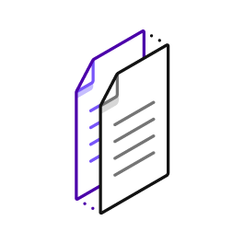

Chiron Framework Workflow
Step 1:
Find your article
Paste the KB link or upload PDF
Generate the AI script
Step 2:
Review the output script
Make any edits or changes
Step 3:
Open Synthesia
Create new scenes for each part
Record lab demo
Choose AI voiceover avatar
Step 4
Make any final edits or changes for video
Upload the video to the desired location
Notes:
Lucas
- Now, diving deeper into the Chiron Framework, the workflow is broken down into four simple steps for SREs to follow:
- Step 1: Is selecting the article you want to convert into a video, then copy pasting the link onto the frontend or for internal KB's download them as PDF's and upload it. Then start generating the script.
- Step 2: Once that's done, you will proofread the generated script and make any edits or adjustments that are required. And after ensuring the script is good to go.
- Step 3: Head over to Synthesia to generate the video through creating new scenes for each part of the script, spin up a lab to record the lab demo showcasing the commands and most importantly choosing your AI voiceover avatar.
- Step 4: Finally make any final edits or adjustments to the video then generate it. Then upload the video to the desired location.

Slide 10
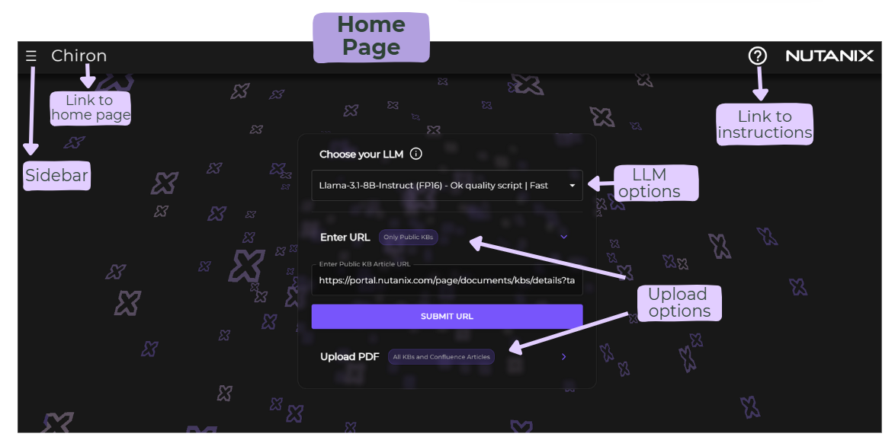
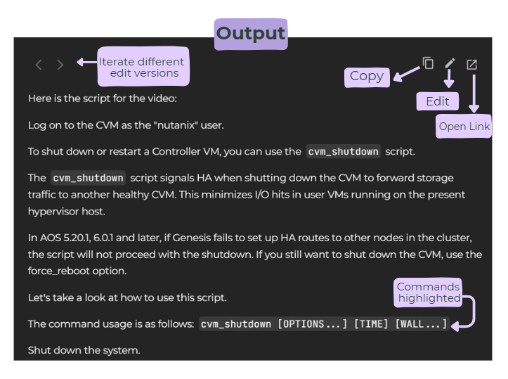
Feature Set
Functional
KB articles into videos
Multiple upload options
Script Tools : Copy, Edit, Undo
Video software includes recording and editing tools
Video elements is updatable
Notes:
Elizabeth
Purple Colorful Organic Mind Map Brainstorm - Brainstorm
Dr. Deepak Sekar - Prof Jim Inc. | LinkedIn
Dyslexia & Format-Based Improvements in Retention and Engagement - Prof Jim Inc.
Why Books Are Better Than Video - Professional Leadership Institute

Slide 11
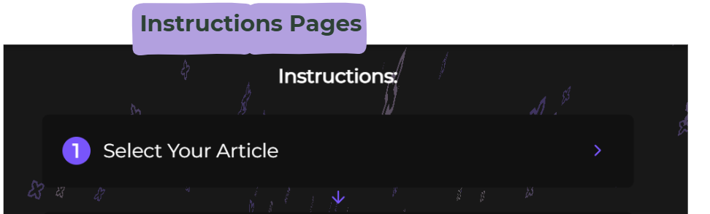
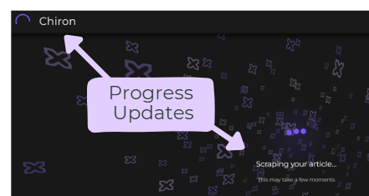
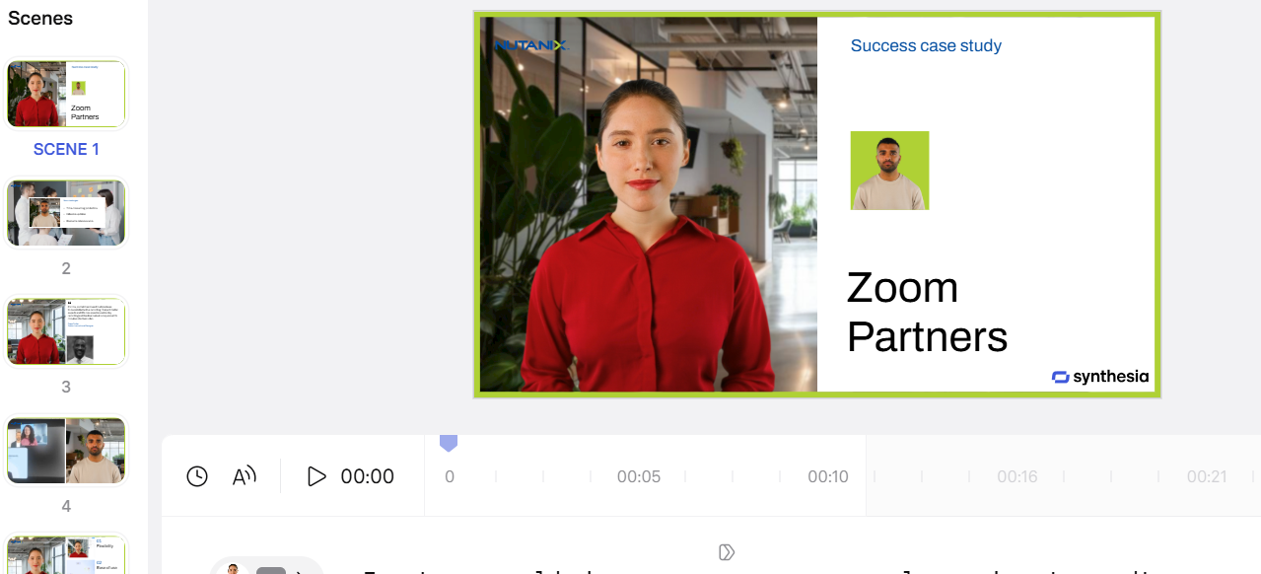
Feature Set
Non Functional
Framework is easy to learn and setup
High quality video
Many narrator options
Operating system agnostic
Approved third-party tools
Informative updates and error messages
Notes:
Elizabeth
Non functional req
Dr. Deepak Sekar - Prof Jim Inc. | LinkedIn
Dyslexia & Format-Based Improvements in Retention and Engagement - Prof Jim Inc.
Why Books Are Better Than Video - Professional Leadership Institute

Slide 12
Demo
Notes:
Adib (Frontend) -> Joseph (Synthesia)
Prerequisites for demo:
HDMI? 🥺👉👈
Have a few generations in the history
For each previous script, have some edits so we can demo this feature
Demo the edits
Demo the instructions
Go into fullscreen (F11)
Nav tabs with Shift+tab
Synthesia
Command line
Ex

Slide 13

Synthesia
All-in-one AI avatar, voice, video editing solution
Easy to use
Currently used in training material
Compared to other solutions like ElevenLabs
Engaging
Different voices, avatars, and languages available
Notes:
Joseph

Slide 14
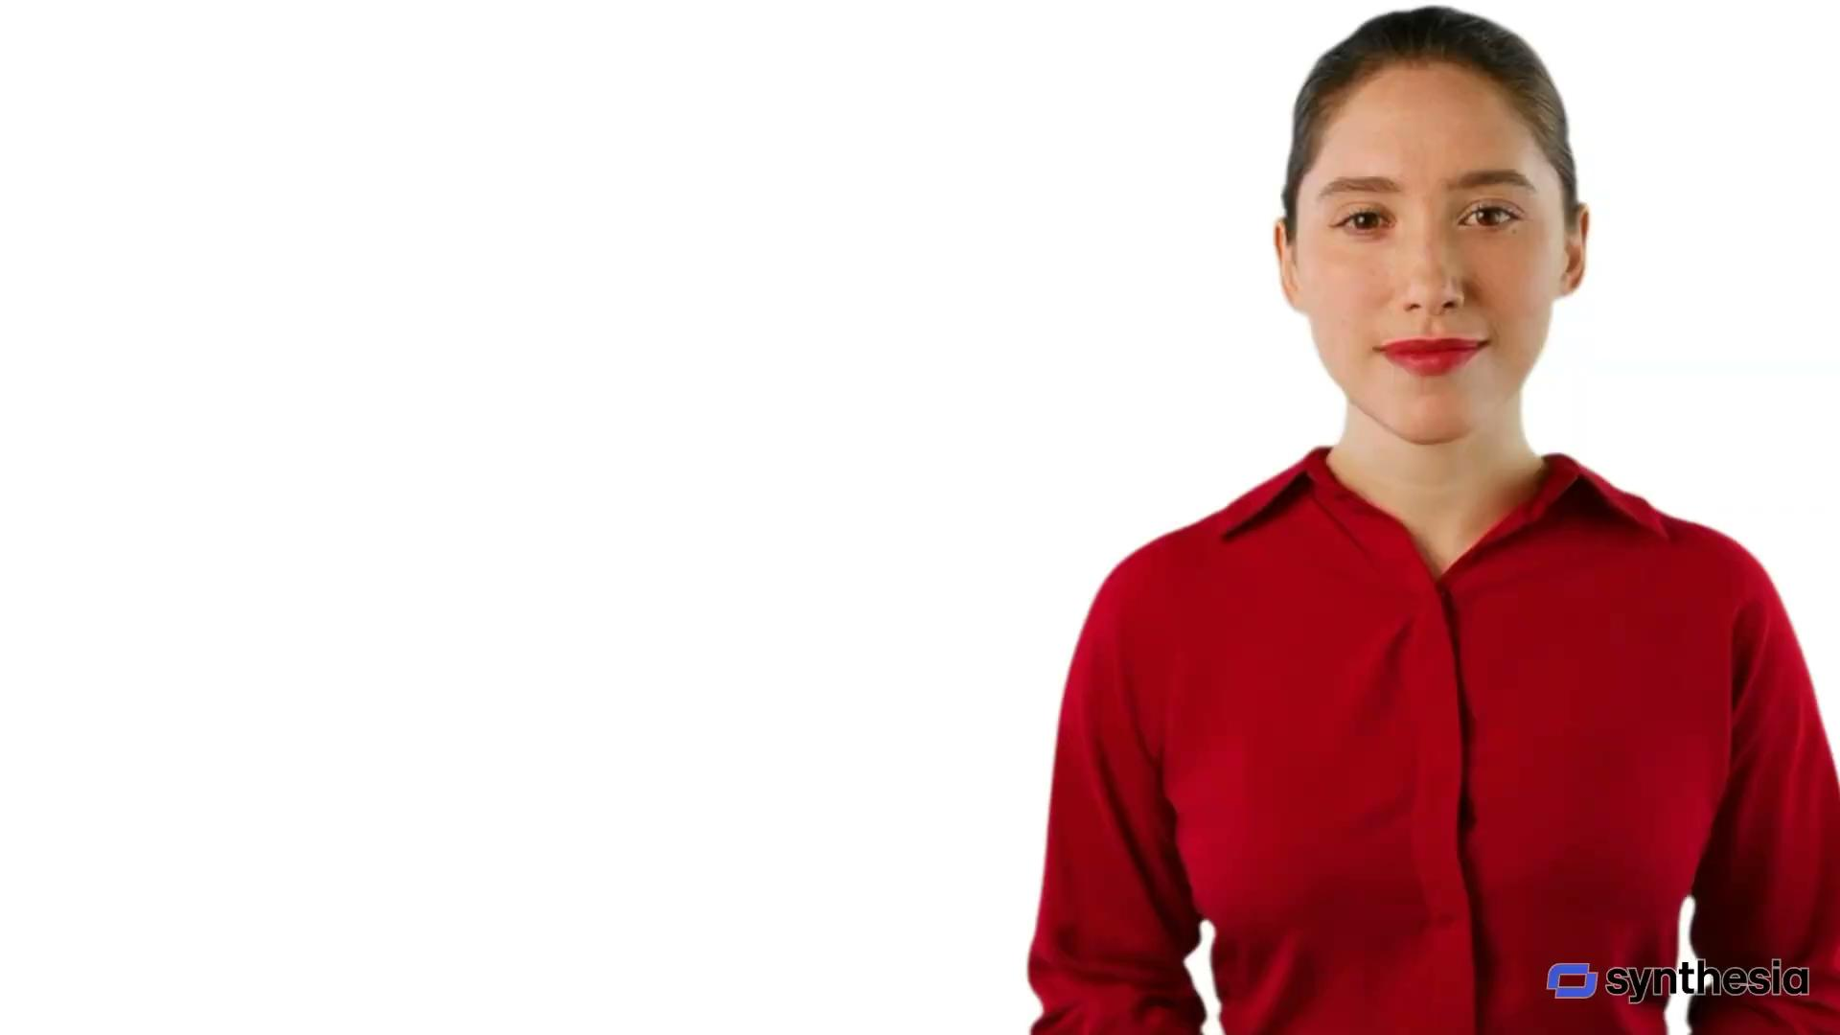
CVM Shutdown Output Video
Nutanix Confidential

Slide 15
Technical Deep Dive
Notes:
Adib

Slide 16
Frontend
Built with React and Material-UI:
Modern, responsive interface
Component based architecture
Matches Nutanix branding and style
Streamlines documentation-to-video process:
Clear instructions for script generation and Synthesia usage
Easy access to previously generated scripts
Script editing with version history
Ability to select LLM based on requirements
Notes:
Adib

Slide 17
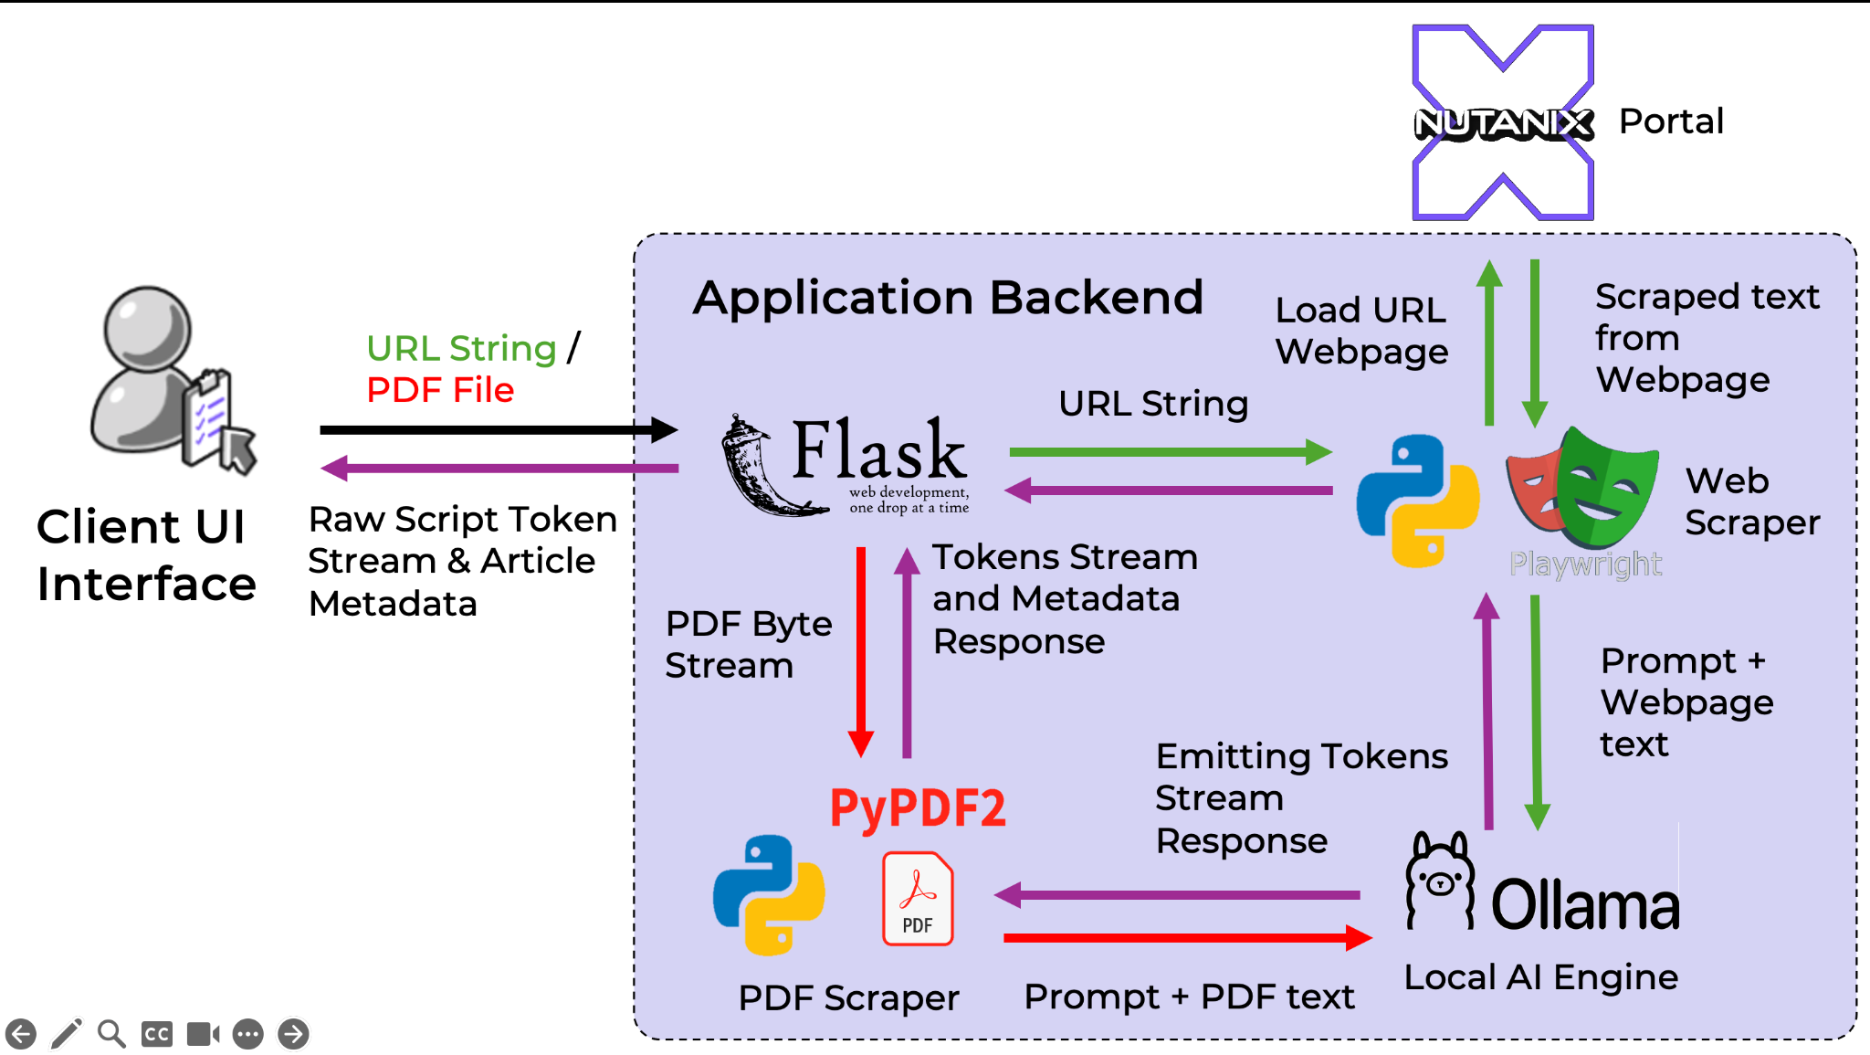
Backend
Notes:
Biswas

Slide 18
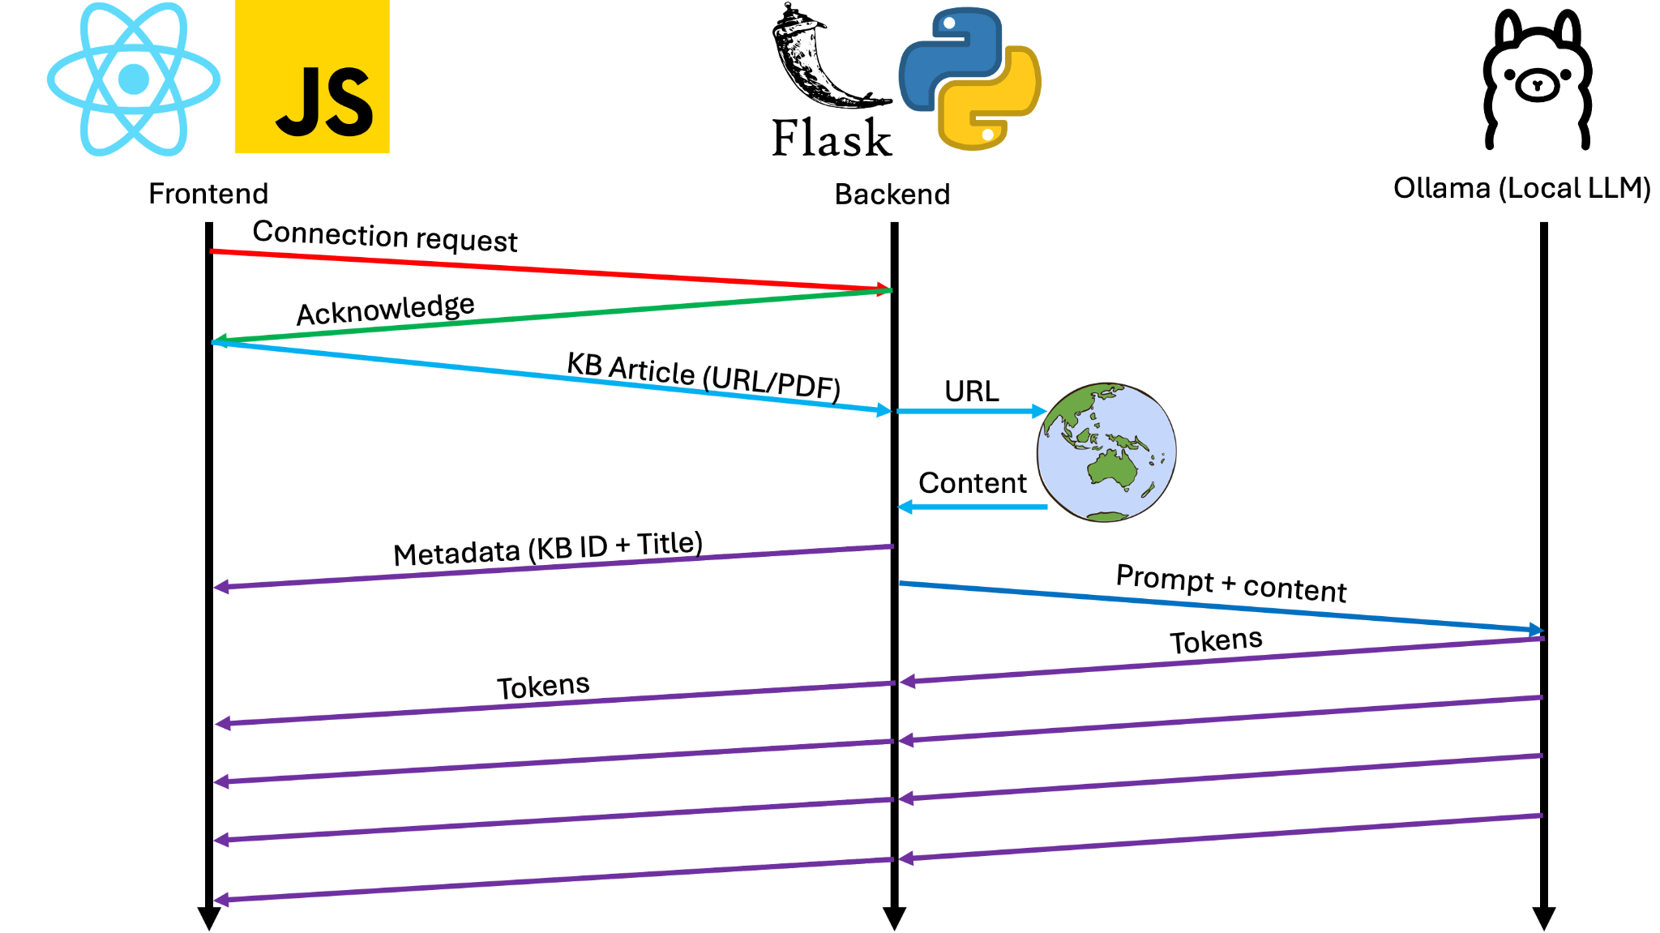
Websockets
Nutanix Confidential
Notes:
Bill

Slide 19



Usage Requirements
Computer
Nutanix KBs & Documentation
Synthesia AI Account
Chiron Framework Image
Access to a lab cluster
Notes:
Leo

Slide 20
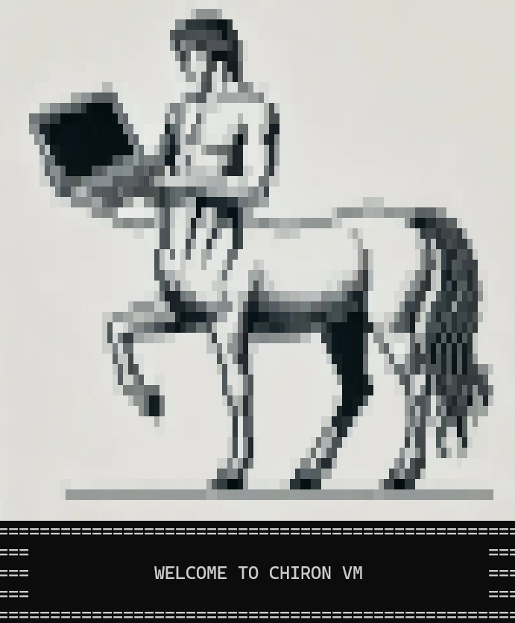
Chiron Environment (OVA)
Easy for SREs to create and run Chiron VM.
Frontend, backend, AI models all packaged into OVA file.
Built-in scripts to automate deployment process.
IP Address of VM used to access frontend.
Runs on a Nutanix Cluster.
Notes:
Leo

Slide 21

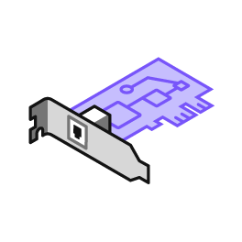


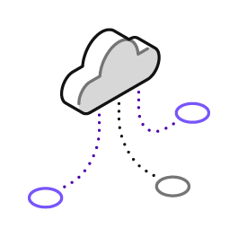
Recommended/Required VM Resources
>32 Cores
Network Adapter Attached on VM Creation
Nutanix Cluster
(RX or Static Lab)
190 GB Memory
Networking Set Up on Cluster (Internet Access)
Notes:
Leo

Slide 22
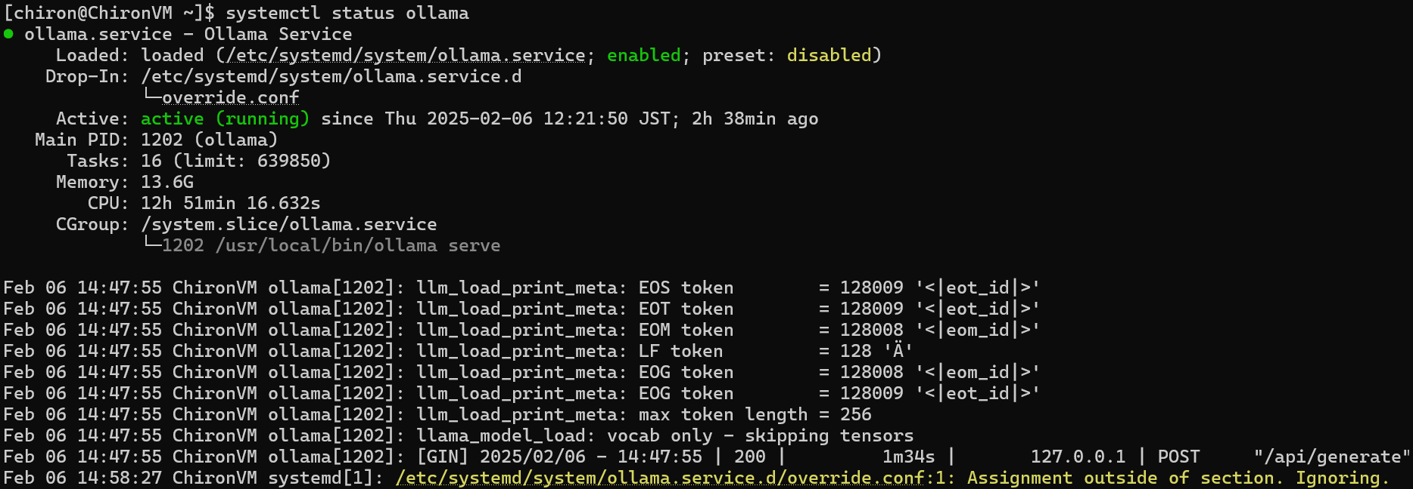
Chiron VM Services
Ollama - Runs AI model locally for script generation.
Nginx - Runs frontend server that hosts frontend website.
Flask - Runs backend server scraping and connects to Ollama.
Notes:
Leo

Slide 23

Chiron VM Setup Video
Notes:
Leo

Slide 24
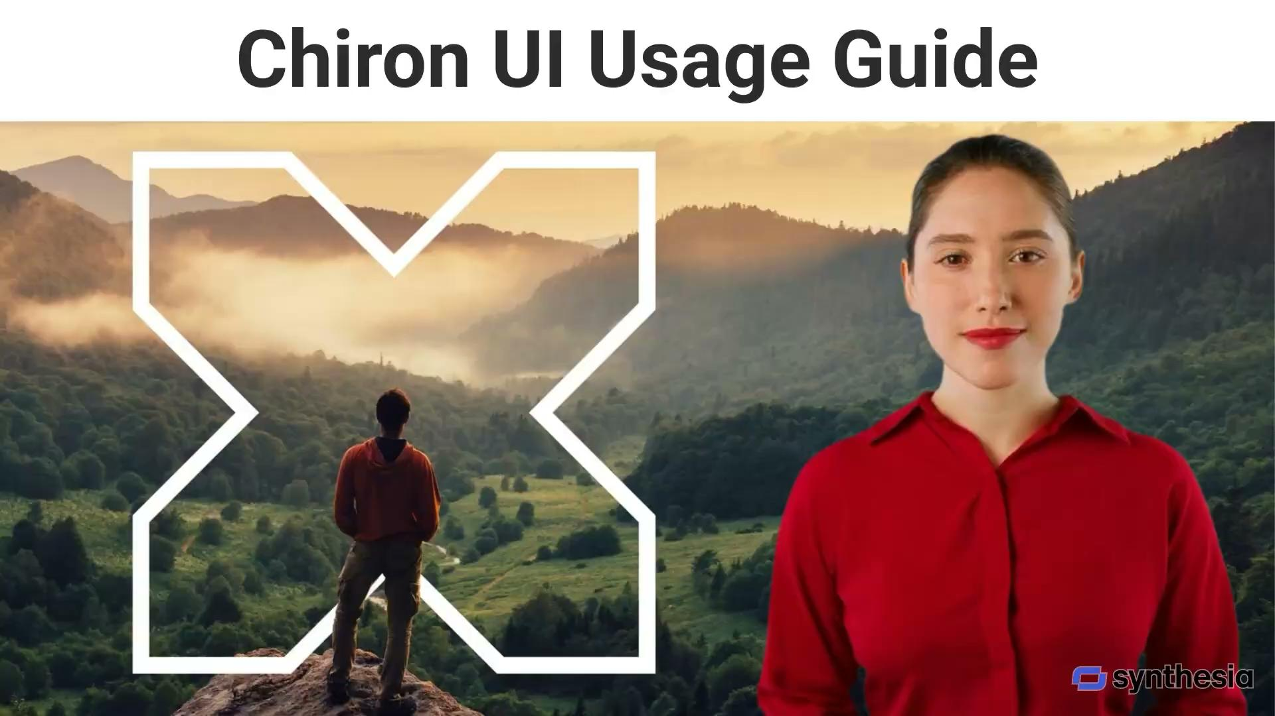
Chiron UI Usage Guide
Notes:
Leo

Slide 25

Synthesia Tutorial Video
Notes:
Leo

Slide 26
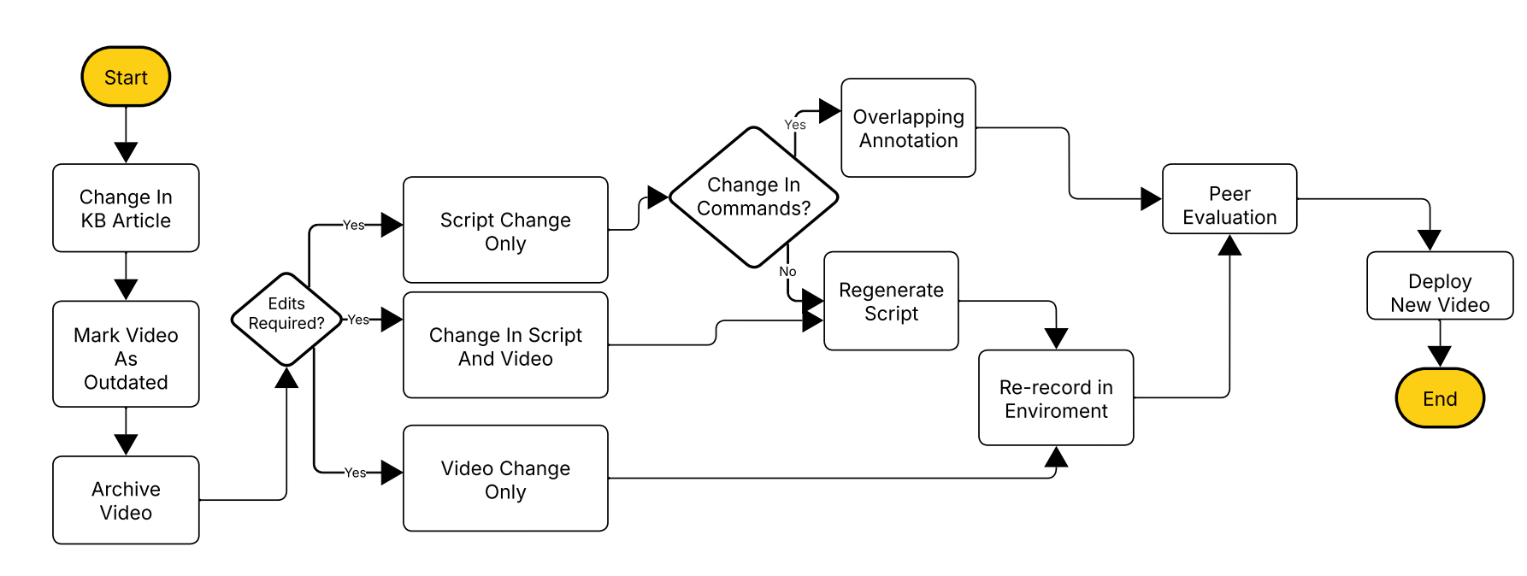
Maintenance
Notes:
Elizabeth
Moving forward it would be ideal to have a workflow which is more efficient and to the point
Blank diagram: Lucidchart
Computer
Access to a lab cluster
Chiron Framework Image
Public KB
AI Software Account (TBC)

Slide 27





Constraints
Hardware Limitations
Concurrent Usage
Automation of Video Creation
Document Length Limits
Prompt
Synthesia
Notes:
Sandin
Hardware: no gpu -> cpu speed slower, quality vs speed tradeoff, ram constraint
Slow gen on cpu -> we’ve prevented multiple ppl gen script same time by implementing a queue
Video creation isn’t automated, since the scope of KBs are too much
Automation of cli in-out could be possible, but KBs cover UI actions, so not feasible to implement general solution
Sensitive information must be removed according to KB guides, in vids, IP and stuff must be manually censored
Article updates require redoing entire vid top to bottom
Explain context window, ram requirements

Slide 28




Future Enhancements
Testing
Video Hosting
Prompt Editing
Copilot Integration
Notes:
Bill

Slide 29
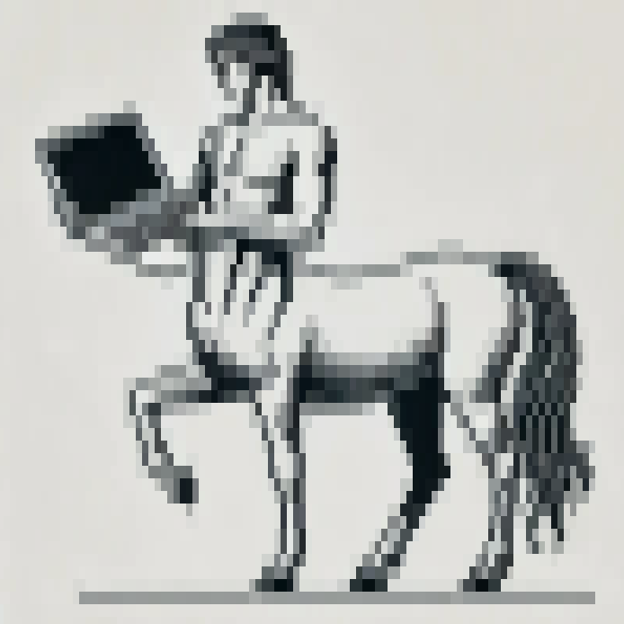
Questions?

